Slide 1
EMOTION RECOGNITION USING AI

Slide 2

Hello!
We are team Pratikar
ABHINAV KUMAR 1SI17CS001
ATHMIYA HB 1SI17CS017
AYESHA SULTHANA 1SI17CS019

Slide 3
INTRODUCTION
Emotions are slave to our thoughts and we are slave of our emotions.
Facial expression convey non-verbal cues, which play an important role in interpolation relations and used in behavioural science.
The project is developed and trained in such a way that 97 % of accuracy is obtained. The project is trained by kaggle dataset

Slide 4
Abstract
Artificial Intelligence can detect emotion just the way humans do, from multiple channels.
This project proposes an implementation of a general convolutional neural network (CNN) building framework for designing CNNs which accomplishes the task of emotion detection.
The final native web application which will take the input image of the user, will process it and predict the emotion of the person.

Slide 5
motivation
According to global survey that design to access the feelings of people around the world, people are feeling more angry, sad and worried than ever before.
Nowadays most of the people are subjected to major depression, or major depressive disorder.
Left untreated, depression can lead to serious health complications, including putting your life at risk.

Slide 6
REQUIREMENTS
Visual Studio
Flask
sqLite database
Python 3.7,Opencv,Tkinter,PIL,Numpy
Keras
&
DESIGN

Slide 7
design
The application follows a modular design.
The users need to login with the credentials and all they need to do is to take their picture from the web cam that opens on this web application.
The graph of the current emotion is displayed on the website.

Slide 8
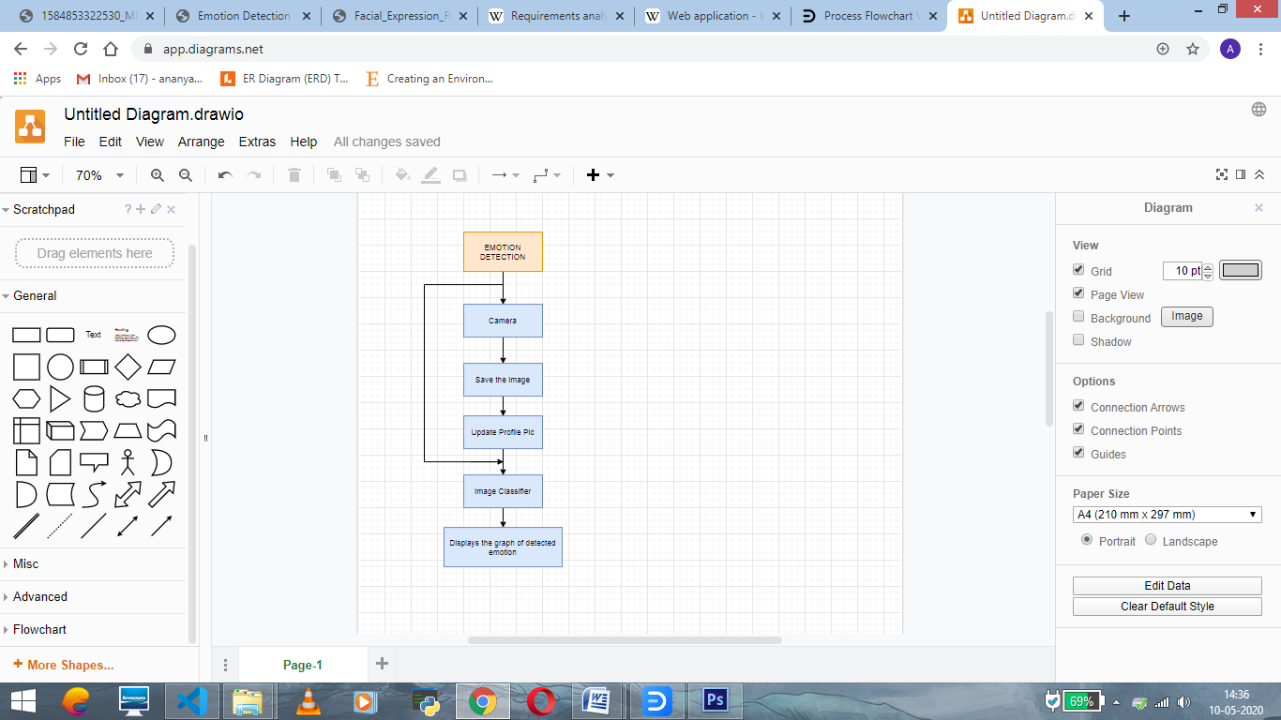
Work Flow of Emotion Detection Module

Slide 9
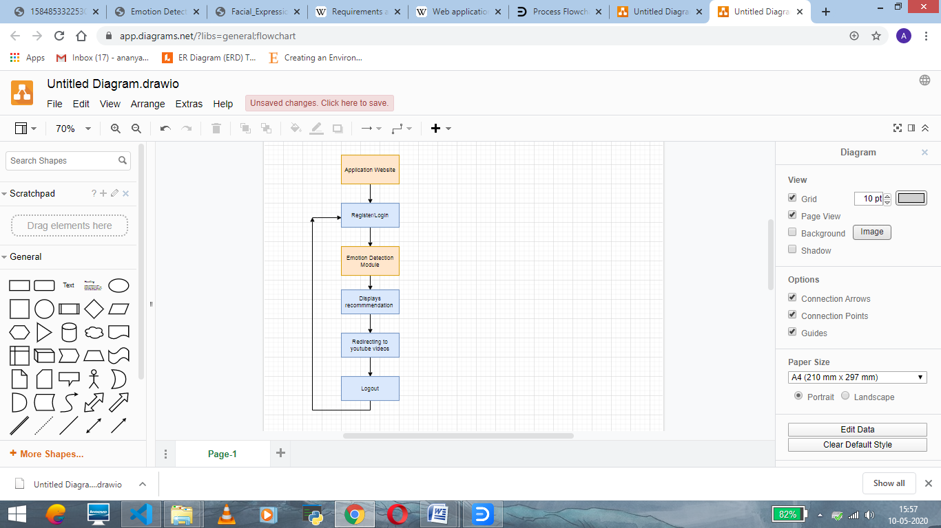
FLOW DIAGRAM of Application Website

Slide 10
IMPL EMENTATION

Slide 11
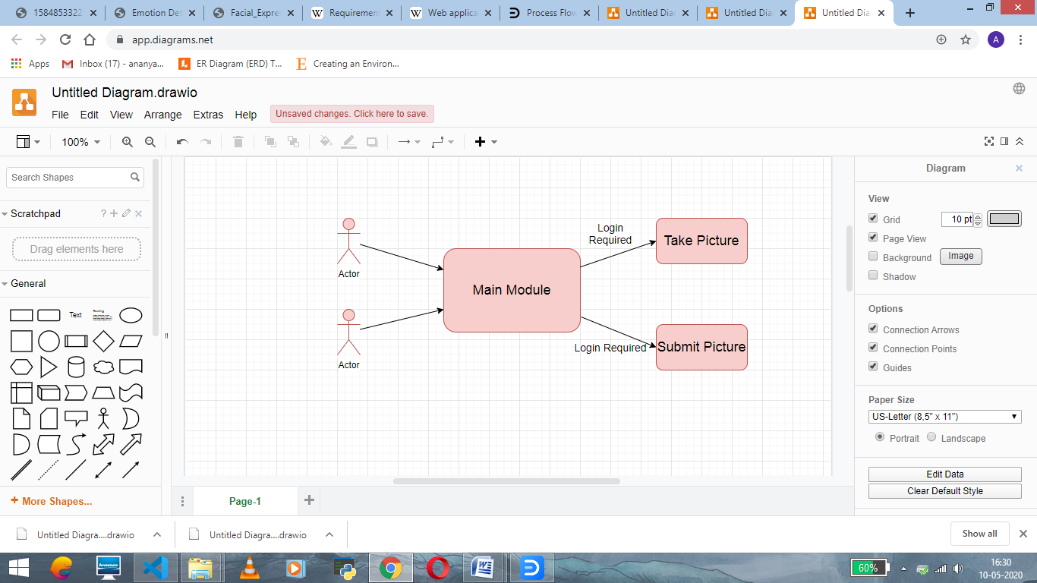
Use case diagram

Slide 12
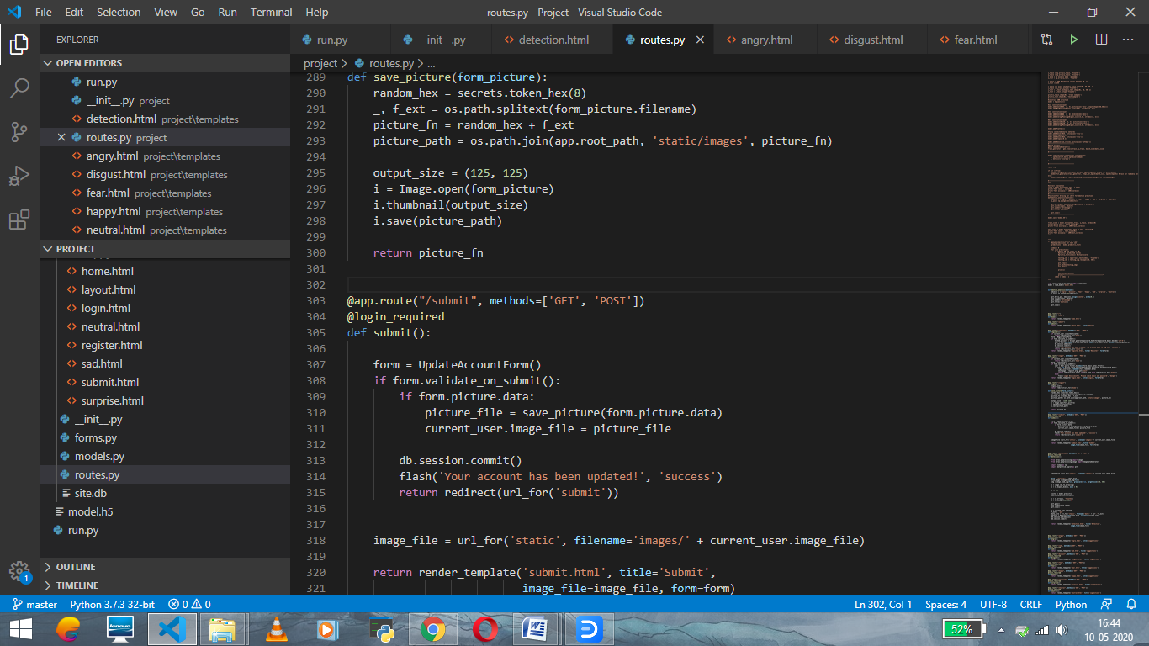

Slide 13
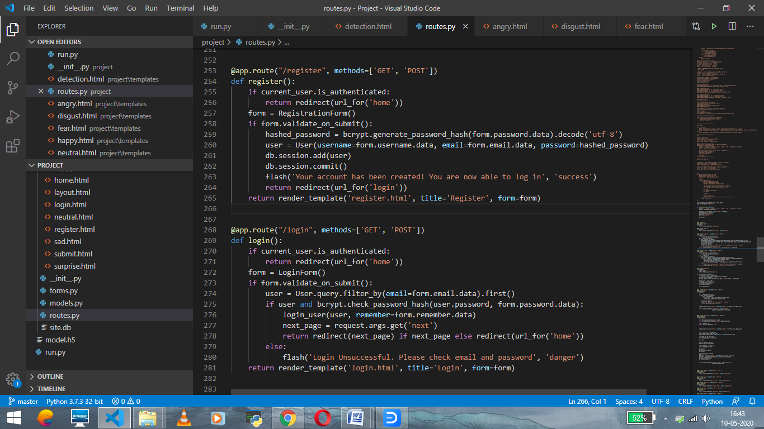

Slide 14
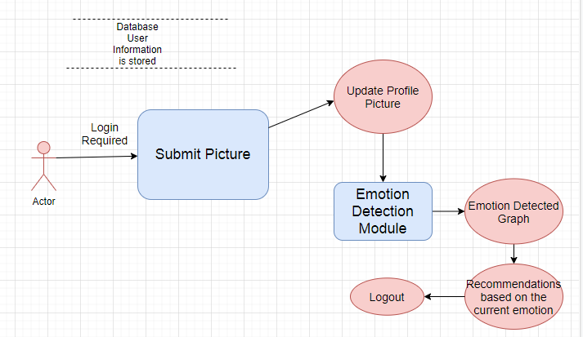
Use case diagram of submit picture

Slide 15
result

Slide 16
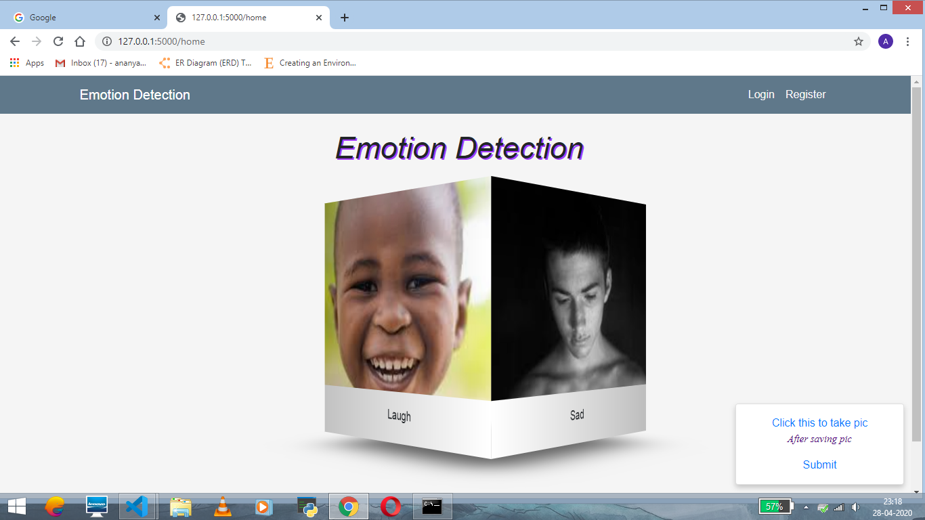

Slide 17
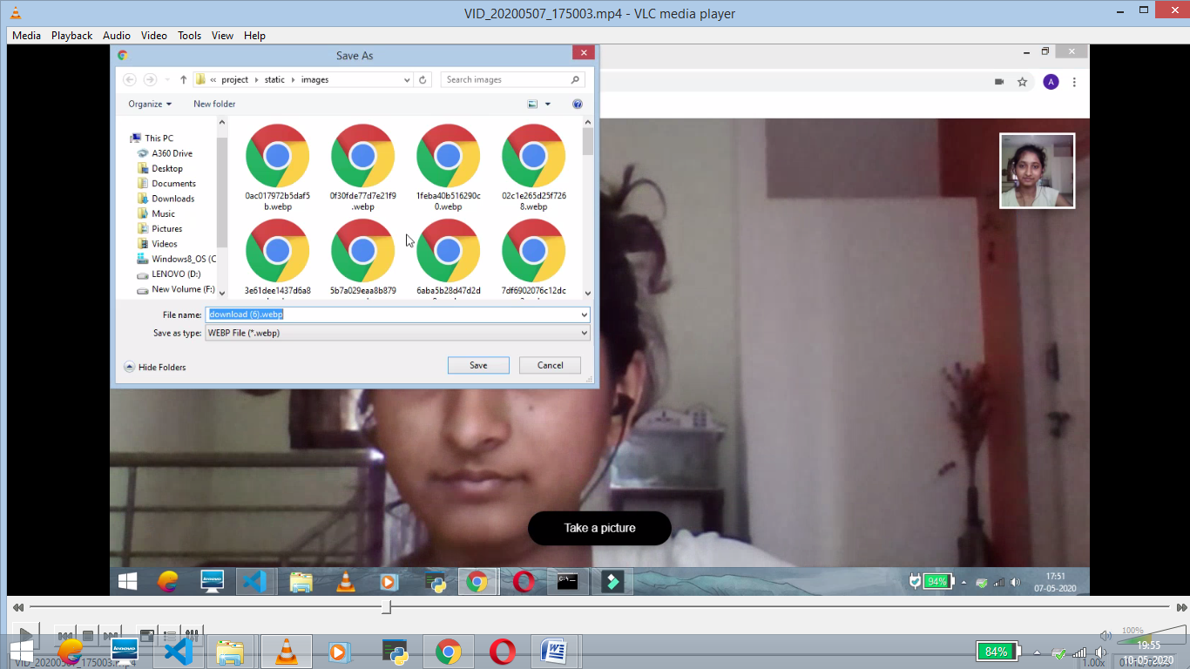

Slide 18
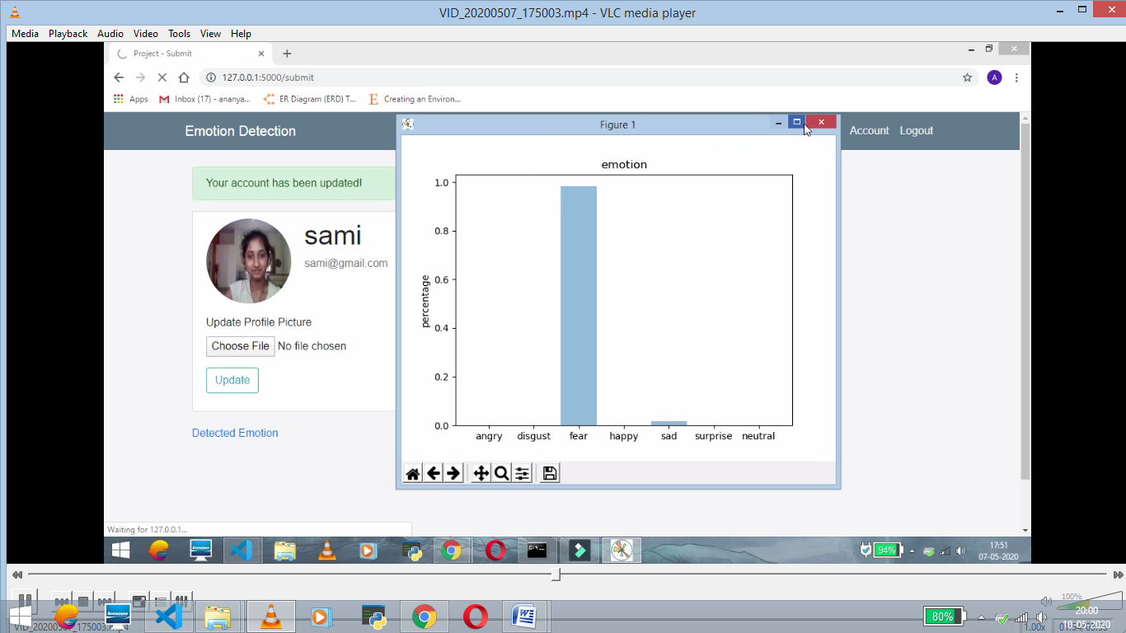

Slide 19
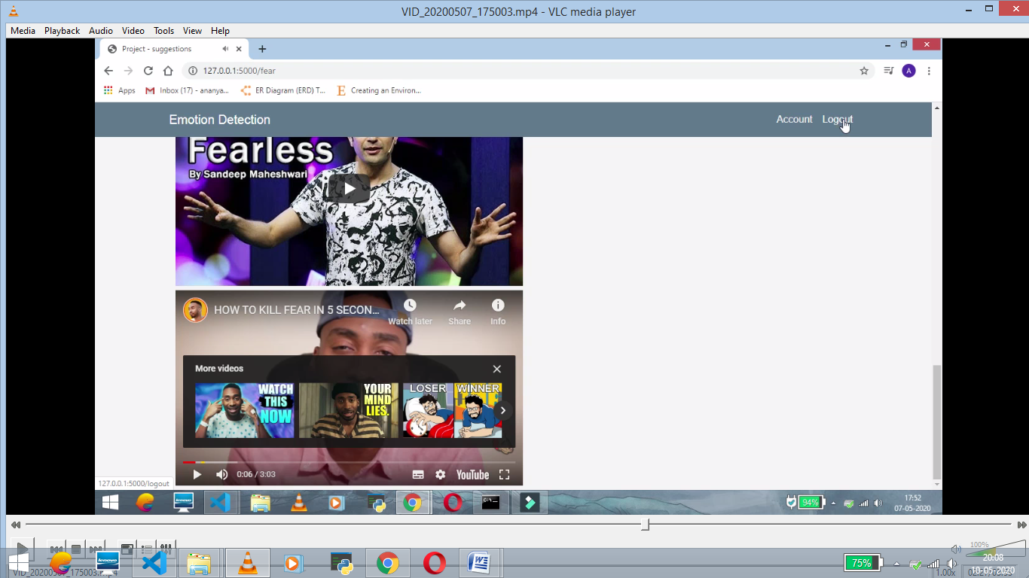

Slide 20
CONCLUSON
The aim of the web application is to detect the emotion of the user and suggest the activity that need to be performed for the user.
This helps people to come out of depression, stress, anxiety and other such things.
It has an accuracy of 97% for coloured images.

Slide 21
REFERENCES
https://www.researchgate.net/publication/322103128_Facial_Expression_RecognitionSystem_using_Convolutional_Neural_Network
Facial Expression Recognition System using CNN by Deepesh Lekhak
https://en.wikipedia.org/wiki/Requirements_analysis
https://en.wikipedia.org/wiki/Web_application
https://www.kaggle.com/c/challenges-in-representation-learning-facial-expression-recognition-challenge

Slide 22
Thank you

